Slide 1

PIXEL ART
EDITOR
Jamil Kabir Hridoy(1931032642)
Nafis Ul Islam Nafis (2513053642)
Md. Shaiful Islam (2511965642)
Salman Farsy (2513446642)

Slide 2
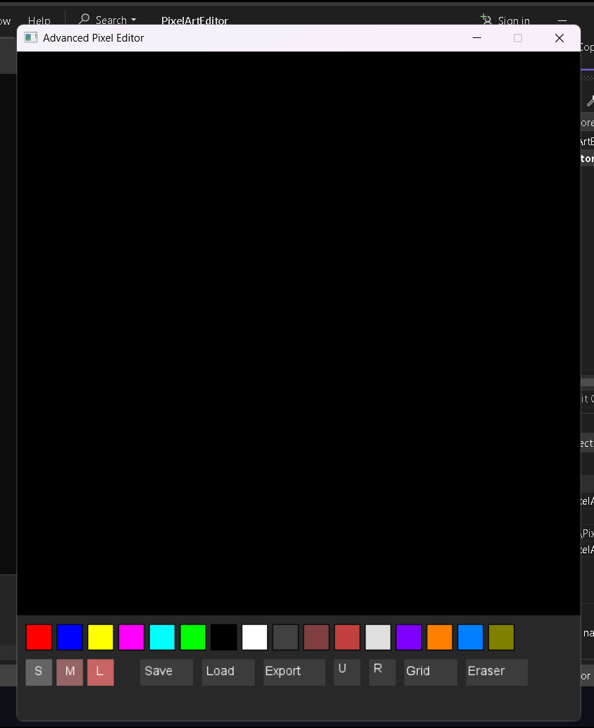
Significance
We wanted to build something graphical and real-time
Creative C and SDL2 gave full control of performance and design
Focus: tools you’d expect in a real pixel art editor
PROJECT 6 JAMIL KABIR HRIDOY NAFIS UL ISLAM NAFIS MD. SHAIFUL ISLAM SALMAN FARSY

Slide 3

System Overview
32×32 Pixel Grid
Undo/Redo (up to 10 steps)
Multiple Brush Sizes
Eraser + Color Palette (16 colors)
Grid Toggle
Export to BMP
Save/Load from file
PROJECT 6 JAMIL KABIR HRIDOY NAFIS UL ISLAM NAFIS MD. SHAIFUL ISLAM SALMAN FARSY

Slide 4
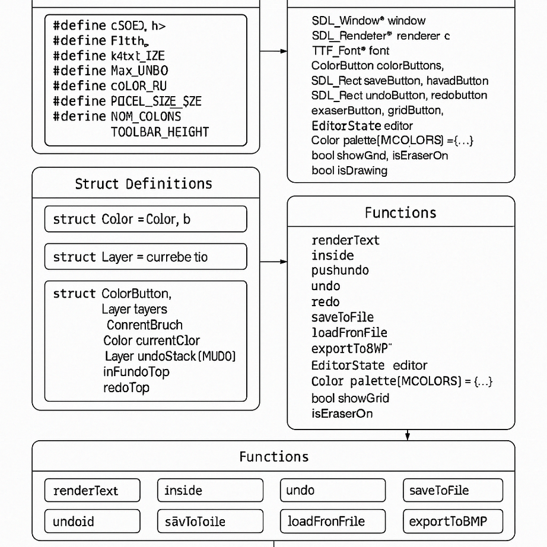

Architecture Overview
EditorState Struct: Tracks current layer, brush, colors, history
Layer System: 3 layers, each a 2D color grid.
Vent Loop: Handles UI clicks, drawing logic.
Rendering: SDL2 + SDL_ttf for canvas + UI
(Diagram: UI, canvas, state)
PROJECT 6 JAMIL KABIR HRIDOY NAFIS UL ISLAM NAFIS MD. SHAIFUL ISLAM SALMAN FARSY

Slide 5

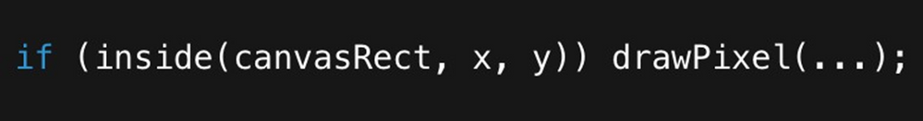
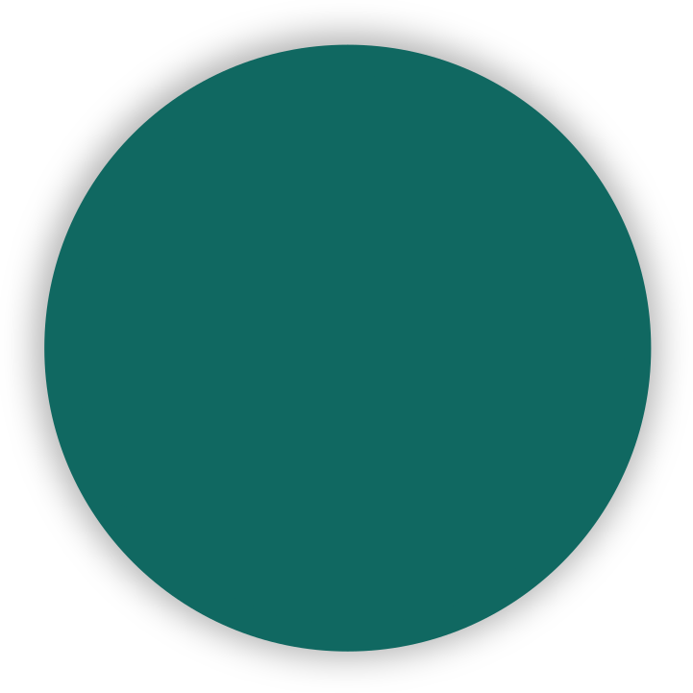
Input Handling
01
02
03
04
Mouse clicks:
canvas or buttons
Drawing only allowed within canvasRect
Brush strokes save one undo per drag
Mouse motion triggers real-time drawing
PROJECT 6 JAMIL KABIR HRIDOY NAFIS UL ISLAM NAFIS MD. SHAIFUL ISLAM SALMAN FARSY

Slide 6

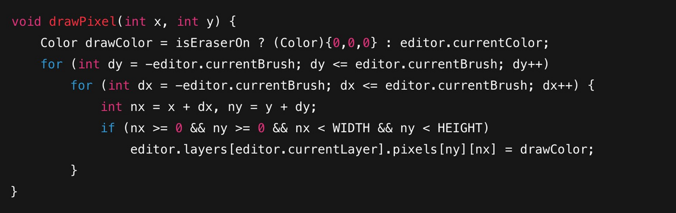
Drawing Pixel
1. Draws with current brush radius
2. Works for brush and eraser
3.Optimized to avoid bounds issues
PROJECT 6 JAMIL KABIR HRIDOY NAFIS UL ISLAM NAFIS MD. SHAIFUL ISLAM SALMAN FARSY

Slide 7

RENDERING UI + CANVAS
All UI drawn manually via SDL_Rect
Buttons: brush sizes, color palette, actions
Text rendered using SDL_ttf
Grid lines toggled with a flag
PROJECT 6 JAMIL KABIR HRIDOY NAFIS UL ISLAM NAFIS MD. SHAIFUL ISLAM SALMAN FARSY

Slide 8



Color Palette + Brushes
Palette: 16 Preset Colors
Color Button
Color Button struct stores color + button area
Brushes
Small (1), Medium (2), Large (3×3 area)
Switch with one click
( Image: Color palette + Brush UI)
PROJECT 6 JAMIL KABIR HRIDOY NAFIS UL ISLAM NAFIS MD. SHAIFUL ISLAM SALMAN FARSY

Slide 9
Undo / Redo Mechanism
Fixed-size stacks (MAX_UNDO = 10)
On draw: save previous layer state
Undo = pop from undo stack → push to redo
Redo = inverse
Keeps UI snappy and predictable
(Side diagram: stacks and transitions)
PROJECT 6 JAMIL KABIR HRIDOY NAFIS UL ISLAM NAFIS MD. SHAIFUL ISLAM SALMAN FARSY

Slide 10
File Operations
Save/Load: Raw fwrite/fread of Layer struct. c
Export
Uses SDL_CreateRGBSurface() .
Writes BMP via SDL_SaveBMP() .
Keeps things lightweight and SDL-native.
PROJECT 6 JAMIL KABIR HRIDOY NAFIS UL ISLAM NAFIS MD. SHAIFUL ISLAM SALMAN FARSY

Slide 11
Challenges & Lessons
Structuring state cleanly without OOP.
Handling UI without a UI framework
Managing undo/redo efficiently
Learned a lot about real-time rendering & SDL events
PROJECT 6 JAMIL KABIR HRIDOY NAFIS UL ISLAM NAFIS MD. SHAIFUL ISLAM SALMAN FARSY

Slide 12

Future Works
Layer Switching
Frame-by-frame
Animation
migrate to WebAssembly for browser version
Aaron Loeb
Custom color picker
break down into smaller files for maintainability
Claudia Alves
Everest Cantu
Olivia Wilson
PROJECT 6 JAMIL KABIR HRIDOY NAFIS UL ISLAM NAFIS MD. SHAIFUL ISLAM SALMAN FARSY

Slide 13
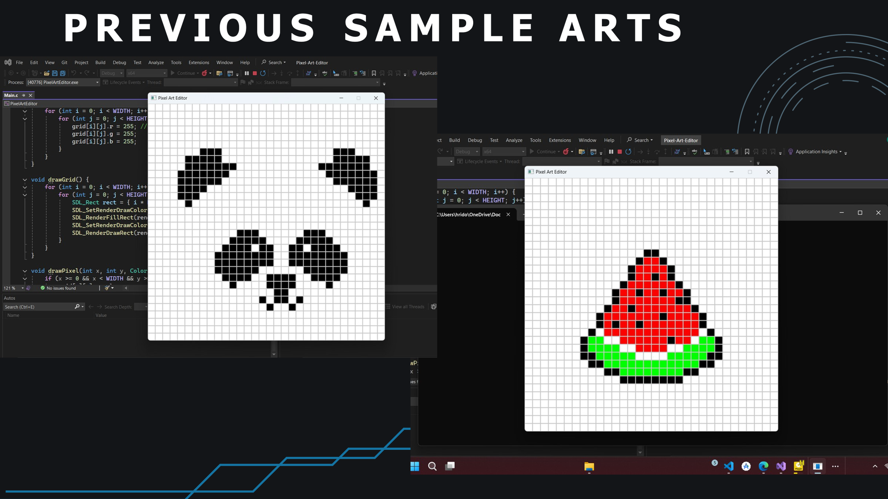
PROJECT 6 JAMIL KABIR HRIDOY NAFIS UL ISLAM NAFIS MD. SHAIFUL ISLAM SALMAN FARSY

Slide 14
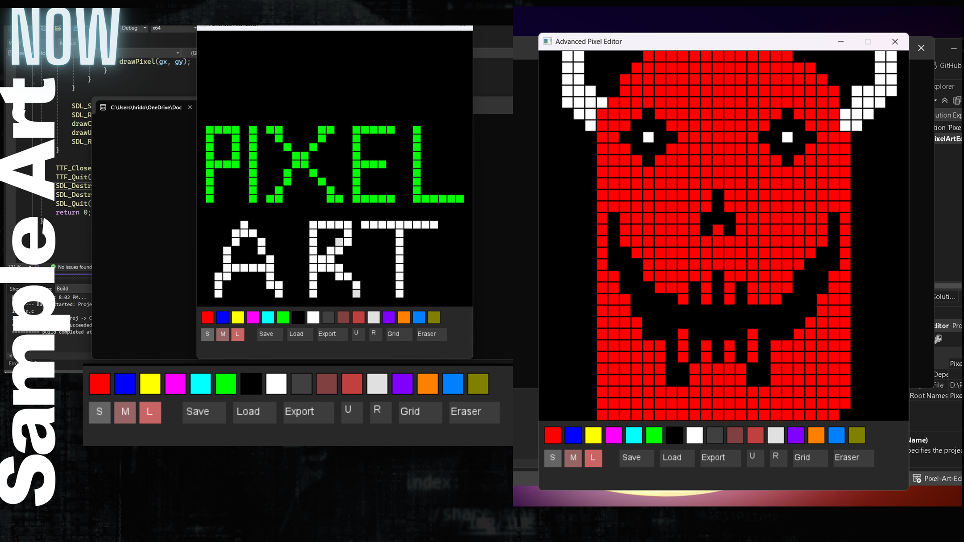
PROJECT 6 JAMIL KABIR HRIDOY NAFIS UL ISLAM NAFIS MD. SHAIFUL ISLAM SALMAN FARSY

Slide 15


